Slide 1
Welcome to Digital Technologies
Or we might just call it Digi Tech

Slide 2
PAPS
Programmers are Problem Solvers

Slide 3
PAPS
Home Entertainment – Computer programmers fixed that problem
City traffic management -- Computer programmers fixed that problem
Calculations -- Computer programmers fixed that problem
Writing -- Computer programmers fixed that problem
Assignments -- Computer programmers fixed that problem
Space Exploration -- Computer programmers fixed that problem
Smart Phones -- Computer programmers fixed that problem
Record Players ??? -- Computer programmers fixed that problem
Cassette Players ??? -- Computer programmers fixed that problem
Can you think of anything else?

Slide 4
Digi Tech
Who can tell me what these two symbols represent?

Slide 5
Digi Tech
There are many answers but what if the symbols are laid out in a different way, then what do they mean?

Slide 6
Digi Tech
Did anyone think of them as a ‘Zero’ and a ‘One’
Have you ever heard of ‘binary’?, it is basically a way of counting and in binary there is only two numbers and they are zero and one, confused.
A computer is one of the smartest things in the world, True or False?
Fun Fact #1 Computers can only read two numbers ‘Zero’ and ‘One’, does this change your answer to the last question?
The zero and one can also be looked at as ‘OFF’ and ‘ON’, the zero for off and the one for on and this is why they now use the zero and one as the world wide symbol for the power button on most appliances.
As you progress through Digi Tech you will learn much more about binary and the way that computers work, for now though we need to look at how a computer thinks.

Slide 7
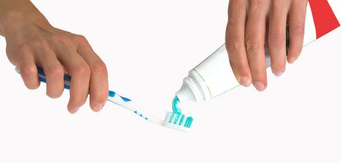
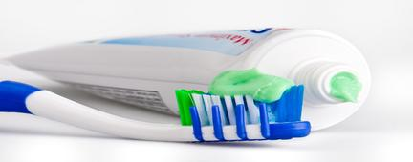
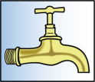
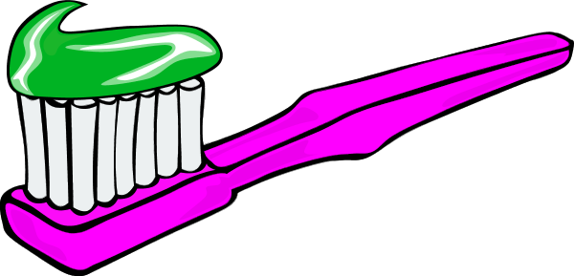
Digi Tech
Your task right now is to open a word document or similar and tell me how to brush your teeth, step by step ( but be careful as you may need to add some steps after I have had a look).

