Slide 1
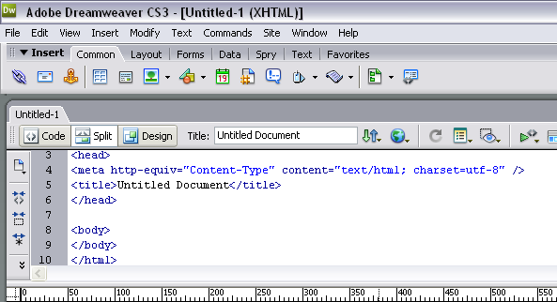
Learning HTML
Learning HTML

Slide 2
>
Basic Tags
Tells Browser
This is an HTML page
<html>
<head>
<title>Title of page</title>
</head>
<body> This is my first homepage.
</body>
</html>
Header information not displayed. Keywords describe page content, used by search engines
Page Title displayed in browser window
HTML tags end with </>
Body contains page formatting and content.
Tells Browser
End of HTML page

Slide 3

HTML
<HTML>
<Head>
<Title>
</Title>
</Head>
<Body>
</Body>
</HTML>

Slide 4
Keywords
HTML – stands for Hyper Text Mark up Language
It’s made up of Tags
Tags are used to show the HTML elements on a web page
HTML tags are surrounded by the two characters < and >
The surrounding characters are called angle brackets
They come in pairs like <b> and </b>
First tag is the start tag, the second tag is the end tag
The text between the start and end tags is the element content
Tags are not case sensitive, <b> means the same as <B>

Slide 5
Elements and Tags
Each part of an HTML page is called an Element. Elements are made of Tags. Tags are surrounded by Angle Brackets. The first one is the Start Tag and the second one is the End Tag. What’s in between is the Element Content and this is what you see on the Web Page.
Example Tags
Start Tags
End Tags
<b> This text is bold </b>
Element Contents

Slide 6
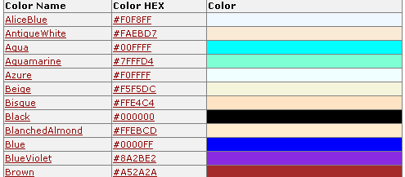
Choosing Colours
When choosing Colours for your Fonts, Borders or Background you can either use the Colour Name or the Colour HEX

Slide 7
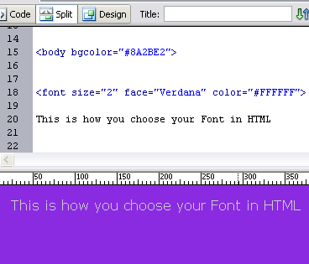
Choosing Colours
Attribute for background colourt
Font Attributes Size, Font Type and Colourt

Slide 8
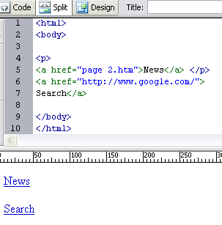
HTML Links (Hyperlinks)
Adding Hyperlinks to web pages is quite easy. Look at the example below in Dreamweaver.

Slide 9
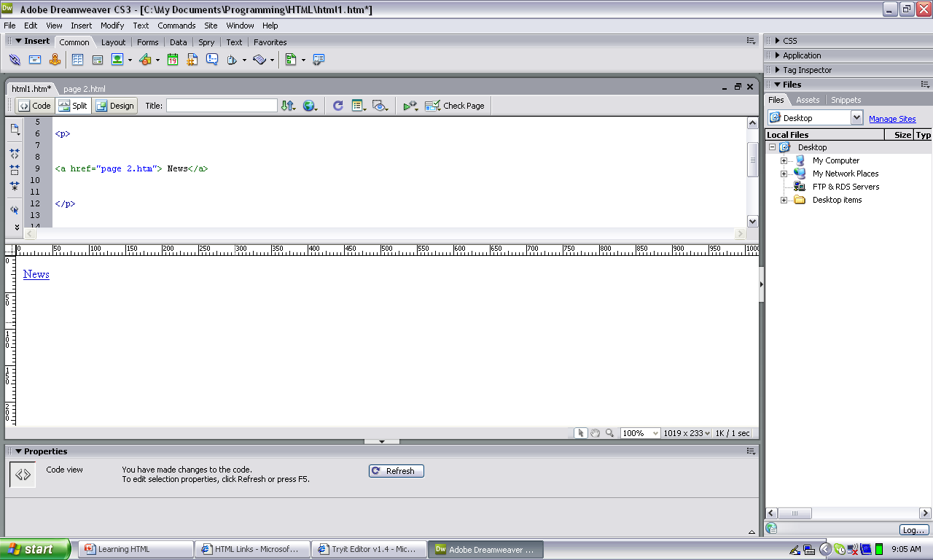
HTML Links (Hyperlinks)
A paragraph creates space around the link <p> This looks clearer for the user.
This is how you write a hyperlink in HTML
This is how the link looks on the page

Slide 10
HTML Links (Hyperlinks)
a means Anchor
page 2.htm is the page you link to
href means
hyperlink reference
News is the link that you see on the page

Slide 11
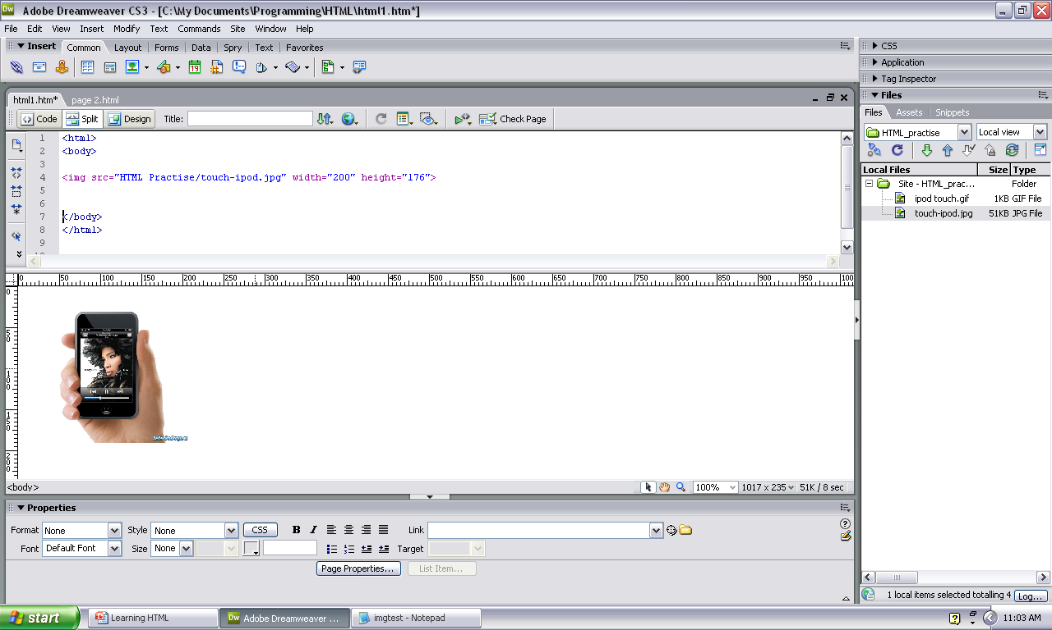
Inserting Images
In HTML, images are defined with the <img> tag and a src attribute. Src stands for "source". The value of the src attribute is where the image is stored. Sound complicated? Once you look at the example, it’s easy to understand

Slide 12
Inserting Images
Start with
<img src =
With speech marks say “where the image is stored and its’ name”
You can add other attributes such as image size

Slide 13
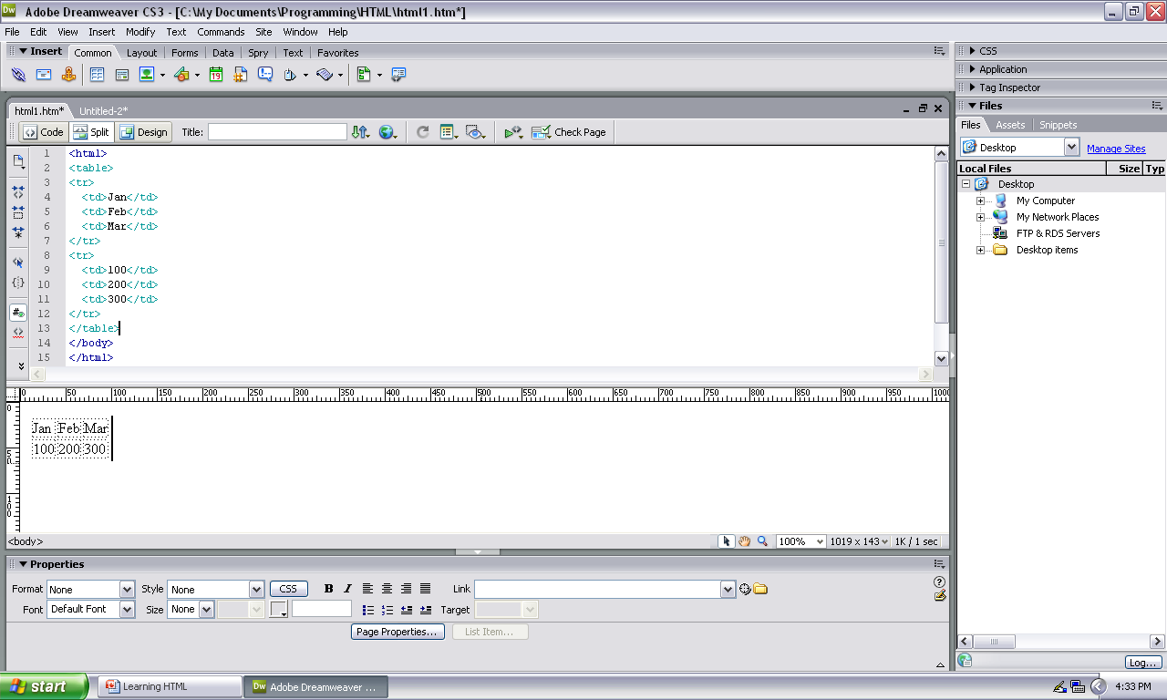
Tables
Creating tables for information or pictures makes your page look better. The HTML code for tables is easy if you remember
Table <table>
Row <tr>
Data <td>

Slide 14
Tables
Start with the Table Tag
Add the Table Row Tag
Whatever you add to the cell is called Table Data <td>
Close the Row Tag</tr>
Repeat the process to add more Rows and Data
Through the Browser – it looks like this
Use the End Tag </table>

Slide 15

Tables
The First Row in this table uses headings <th>

Slide 16


Attributes
Attributes are features of something (or someone). The attributes of a person include their height, build, eye colour, hair colour etc
Simon
Black Hair
Brown Eyes
Slim Build
Height
170 cm

Slide 17
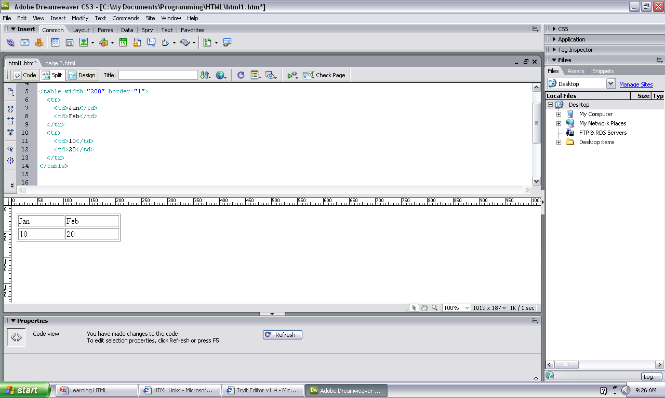
Attributes
When designing web pages you can format the Elements using Attributes.
Examples of Table attributes include
Table width
Border (size)
line colour,
background colour
Values we could give to attributes include
Table width “200”
Border (size) “1”
line colour, “blue”
background colour “green”

Slide 18
Attributes
This is how you write an attribute. They do not need closing Tags.
<Attribute Name =“state value in speech marks”>
Above you can see the table is 200 pixels wide and border size is 1

Slide 19
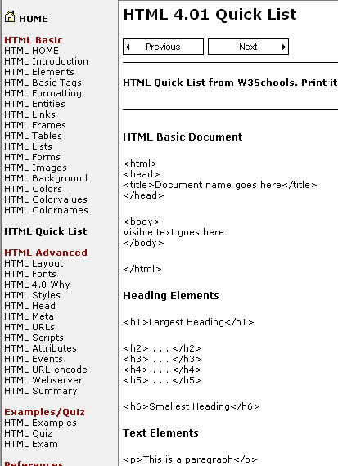
HTML Quick List

Slide 20
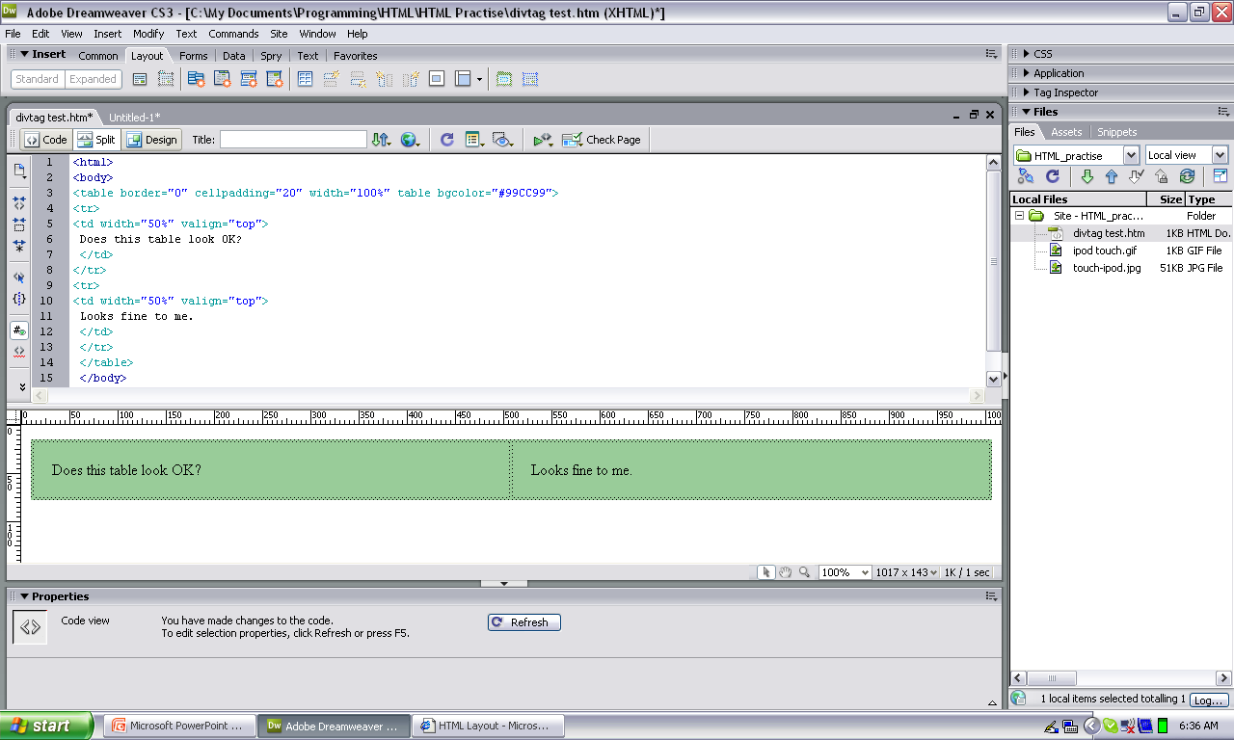
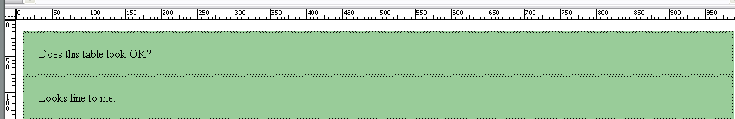
Spot the Mistake
The Table should be like this with two columns. Look at the coding carefully and see if you can spot the problem

Slide 21
Spot the HTML Mistake
The HTML says to end the first row and start a new one. That creates TWO rows when you only need ONE. Solution DELETE the second row.

Slide 22
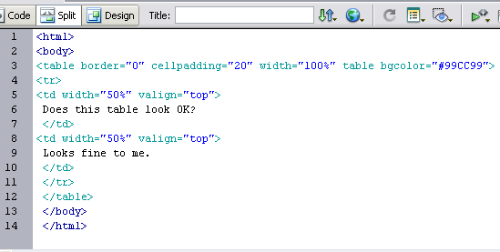
Correct HTML Coding
Start Tag <tr>
End Tag </tr>

